Slide 1
Virtual Clusters Supporting MapReduce in the Cloud
Jonathan Klinginsmith
jklingin@indiana.edu
School of Informatics and Computing
Indiana University Bloomington

Slide 2
Let’s Break this Title Down
Virtual Clusters
Supporting MapReduce
in the Cloud

Slide 3
Let’s Start with MapReduce
An example to get us warmed up…
Map
line = “hello world goodbye world”
words = line.split()
# [“hello”, “world”, “goodbye”, “world”]
map_results = map(lambda x: (x, 1), words)
# [('hello', 1), ('world', 1), ('goodbye', 1), ('world', 1)]

Slide 4
Can’t have “MapReduce” without the “Reduce”
Reduce
from operator import itemgetter
from itertools import groupby
map_results.sort()
# [('goodbye', 1), ('hello', 1), ('world', 1), ('world', 1)]
for word, group in groupby(map_results, itemgetter(0)):
counts = [count for (word, count) in group]
total = reduce(lambda x, y: x + y, counts)
print("{0} {1}".format(word, total))
goodbye 1
hello 1
world 2

Slide 5
What Did We Just Do?
“hello world goodbye world”
Split:
“hello”, “world”, “goodbye”, “world”
Map:
('hello', 1), ('world', 1), ('goodbye', 1), ('world', 1)
Sort:
('goodbye', 1), ('hello', 1), ('world', 1), ('world', 1)
Reduce:
('goodbye', 1), ('hello', 1), ('world', 2)

Slide 6
The “Value” of Knowing the “Key” Pieces*
Map – creates (key, value) pairs
('hello', 1), ('world', 1), ('goodbye', 1), ('world', 1)
Sort by the key:
('goodbye', 1), ('hello', 1), ('world', 1), ('world', 1)
Reduce operation peformed on the value:
('goodbye', 1), ('hello', 1), ('world', 2)
* = Pun intended

Slide 7
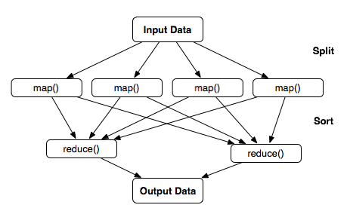
In General then…
Split:
Map:
Sort:
Reduce:

Slide 8
Check “MapReduce” off the List
Virtual Clusters
Supporting MapReduce
in the Cloud

Slide 9
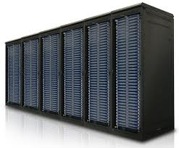
What is a Cluster?
or

Slide 10
Compute Cluster
Set of computers
Proximity
Networking
Storage
Resource Manager

Slide 11
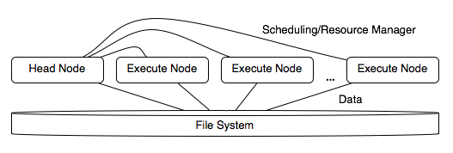
Compute Cluster

Slide 12
Breaking Down Large Problems
Many compute patterns have emerged one such is…
Scatter/Gather:

Slide 13
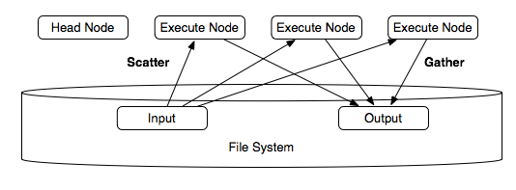
On the Cluster

Slide 14
What if there are a Lot of Data?
Network Bottleneck?

Slide 15
What about Local Node Storage?
Distribute the data across the nodes (scatter/split)
Replicate the data to prevent data loss
Have the file system keep track of where the chunks (blocks) are stored
Scheduling resource will schedule jobs to the nodes storing the data

Slide 16
MapReduce on the Cluster
Data distributed across the nodes (scatter/split) when loaded into the file system

Slide 17
Check “Clusters” off the List
Virtual Clusters
Supporting MapReduce
in the Cloud

Slide 18
Virtual…and…the Cloud
Let’s start with Virtual...
A Virtual Machine (VM)
A “guest” virtual computer running on a “host” physical computer
A machine image (MI) is instantiated into a running VM
MI = snapshot of operating system (OS) and any software

Slide 19
Virtual…and…the Cloud
The Cloud...
Virtualization + Internet ➔ Introduction of the Cloud
Scalability
Elasticity
Utility computing – not a capital expenditure
Three levels of service
Software (SaaS) – e.g., Salesforce.com, Web-based email
Platform (PaaS) – e.g., Google App Engine
Infrastructure (IaaS) – e.g., Amazon EC2

Slide 20
Why is the Cloud Interesting?
In Industry
Scalability – get scale not present in internal data centers
Elasticity – change scale as capacity demands
Utility computing – no capital investiment
Examples use-cases:
High Performance/Throughput Computing
On-line game development
Scalable web development

Slide 21
Why is the Cloud Interesting?
In Academia
Reproduciblity – resuse MIs between researchers
Educational Opportunities
Virtual environment ➔ Variety of uses and configurations
Learn about foundational system components
Collaborate within the same environment

Slide 22
Covered “Virtal” and “the Cloud”
Virtual Clusters
Supporting MapReduce
in the Cloud
Let’s put it all together...

Slide 23
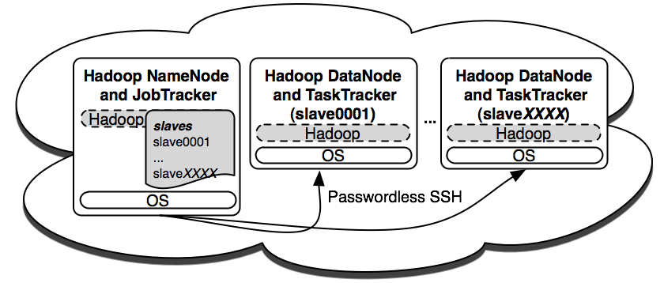
MapReduce Virtual Clusters in the Cloud
Create virtual clusters running MapReduce
Test algorithms
Test infrastructure and other system attributes

Slide 24
MapReduce Virtual Clusters in the Cloud
Research Areas
Bioinformatics – e.g., Genomic Alignments
Data/Text Mining and Processing
Large-scale Graph Algorithms

Slide 25
MapReduce Virtual Clusters in the Cloud
Research Areas
Bioinformatics – e.g., Genomic Alignments
Data/Text Mining and Processing
Large-scale Graph Algorithms

Slide 26
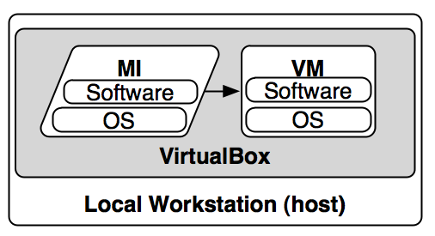
From Virtual Clusters to a Local Sandbox
Use a local sandbox to cover MapReduce topics

