Slide 1
Cyberaide Virtual Appliance: On-demand Deploying Middleware for Cyberinfrastructure
Tobias Kurze, Lizhe Wang, Gregor von Laszewski, Jie Tao, Marcel Kunze, Fugang Wang, David Kramer, Wolfgang Karl, and Jaliya Ekanayake

Slide 2
Outline
Research background: Grid computing & Cloud computing
Research motivation
Cyberaide virtual appliance
Test results
Conclusion and future work

Slide 3
Grid computing
Effective computing paradigm for distributed high performance computing applications
A number of production Grid infrastructures, projects, applications:
TeraGrid, EGEE, WLCG, FutureGrid, D-Grid …
Disadvantages of current production Grids:
Overloaded Grid middleware
Complicated access interfaces and policies
Limited QoS support
No personalized computing environment provision

Slide 4
Cloud computing
That’s why we are here
Attracting features:
On demand service provision
Utility computing model: pay-as-you-go
Customized computing environment provision
Automatic and autonomous service management
User centric interfaces with broad network access
Scalable services with resource pooling
……

Slide 5
Cyberaide Project
An open source project, collaborated between Indiana Univ., KIT, RIT, …
PI: Dr. von Laszewski
A middleware for clusters, Grids and Clouds
Cyberaide virtual appliance
Cyberaide shell
Cyberaide mediator, cyberaide server,
Cyberadie creative
……

Slide 6
Motivation
Challenging question: can we build Clouds on exiting production Grid infrastructures?
Our current research objectives:
On-demand access Grid resources from ad-hoc clients?
SaaS on production Grids?
……

Slide 7
On-demand access production Grids
Interfaces of Production Grids are strictly defined:
Resource information
Security
Job submission and management
Access resources of production Grid
from ad-hoc clients
without special client software & Grid expertise
on-demand access at runtime

Slide 8
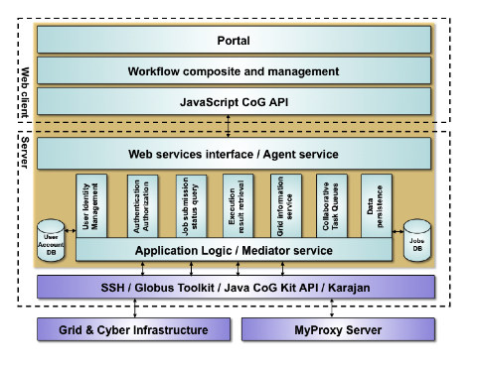
Cyberaide shell, mediator and server

Slide 9
Cyberaide Virtual Appliance: overview
Cyberaide Virtual Appliance
Put cyberadie shell, mediator and server into a virtual machine,
On demand deploy cyberaide virtual appliance to access production Grid
User can access production Grid via cyberaide virtual appliance
Advantages
Cyberaide virtual appliance can be dynamically deployed with policy customization, like user account, access URI, ..
Multiple users can share a cyberaide virtual appliance, then build a VO
A cyberaide virtual appliance can be managed easily, for example, start, shutdown, migration, duplication, ..

Slide 10
Cyberaide virtual appliance: Solutions
Vmware Studio vs. JeOS VMBuilder
JeOS VMBuilder is selected
Criteria | Vmware Studio | JeOS VMBuilder
User interface | Very good | Less comfortable
Support OS | Ubuntu, SUSE, RedHat, CentOS | Ubuntu JeOS only
Support hypervisor | Vmware | Vmware, Xen and KVM
Auto support on hypervisor | Yes | no
Ease of use | Some technical problems | good

Slide 11
Cyberaide virtual appliance: Implementation
Four configuration files for Boot and Login:
A basic configuration file that allows to define some basic parameters such as: platform type (i386), amount of memory of the virtual appliance, packages that should be directly installed, etc.
A hard-disk configuration file that defines the size of each available (virtual) hard-disk and the number and size of all the partitions that will be created on these hard-disks.
Boot.sh: Shell script that will be executed during the first boot of the new appliance.
Login.sh: Shell script that will be executed after the first logon in the new appliance.
One script is for adapting the VMbuilder configuration files
One script is for transferring the appliance to the target host and starting it on the specified hypervisor.

Slide 12
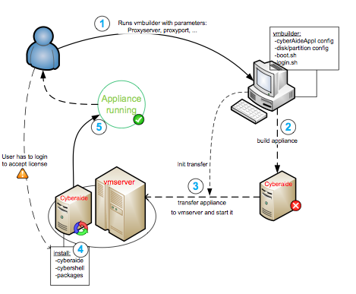
Cyberaide Virtual Appliance: Build process

Slide 13
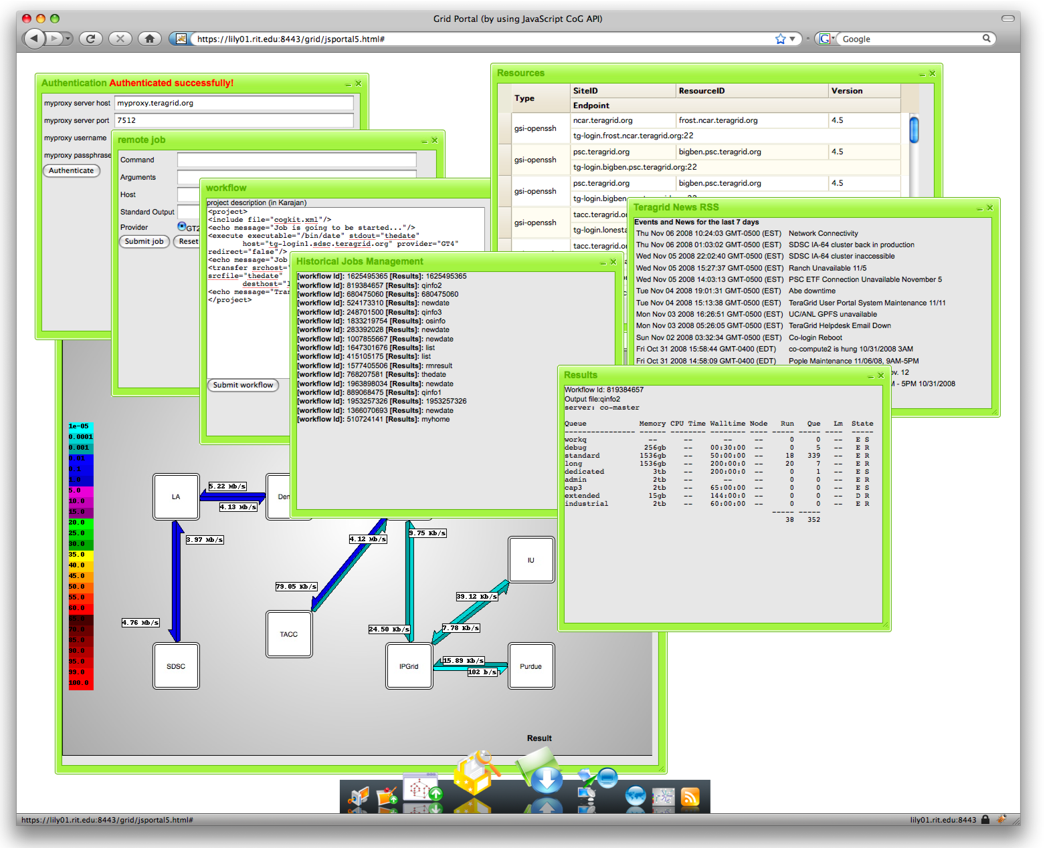
Test result: Web portal on TeraGrid

Slide 14
Test result: performance evaluation on TeraGrid
Metrics | value
Building time (basic OS packages) | 10 minutes
Building time (full system image) | 20 minutes
Deployment time | 15 minutes
Total time | 40 ~ 60 minutes
Virtual machine image size (basic OS package) | 400 MB
Virtual machine image size (full system image) | 2.8 GB

Slide 15
Conclusion and Future work
Cyberaide virtual appliance:
on demand deploy middleware for Grid computing
Test on production Grid
Future work
Cyberaide onServe: Software as Service on production Grid
Cyberaide Farm: develop Cloud computing program model on production Grid
Cyberaide Green: provide green Grid computing & Cloud computing

