Slide 1
TsMap3D - Browser Visualization of High Dimensional Time Series Data
Supun Kamburugamuve, Pulasthi Wickramasinghe, Saliya Ekanayake, Chathuri Wimalasena, Milinda Pathirage, Geoffrey Fox
Dec-05-2016
School of Informatics & Computing
Indiana University, USA

Slide 2
Outline
Overall approach
Multidimensional Scaling
WebPlotViz
Stock Data
Results

Slide 3
Our Approach
Input is a set of items with values at each time step
Segment the time series data into time windows
Define a distance metric between items in a given time window
Correlation
Apply dimension reduction to map these distances to 3D
Multidimensional Scaling
Align the 3D points of consecutive time windows so that they can be visualized
Visualize the data as a moving plot
WebPlotViz

Slide 4
Data Segmentation
Sliding Window
Accumulating Time Window
Start Time
End Time
1 | 2 | 3 | 4 | 5 | 6 | 7 | 8 | 9 | 10
1 | 2 | 3 | 4 | 5 | 6 | 7 | 8 | 9 | 10
1 | 2 | 3 | 4 | 5 | 6 | 7 | 8 | 9 | 10
Start Time
End Time
1 | 2 | 3 | 4 | 5 | 6 | 7 | 8 | 9 | 10
1 | 2 | 3 | 4 | 5 | 6 | 7 | 8 | 9 | 10

Slide 5
Calculate Relationships between items
Start Time
End Time
1 | 2 | 3 | 4 | 5 | 6 | 7 | 8 | 9 | 10
S1 | S1,v1 | S1,v2 | S1,v3 | S1,v4
S2
Sn | Sn,v1 | Sn,v2 | Sn,v3 | Sn,v4
 | dist(s1,s1)
 | dist(s1,s2)
Values for Each item
Distance Matrix of size n x n

Slide 6
Advance Multidimensional Scaling Implementation
Projects high dimensional data into a lower dimension (i.e. 3D) approximately preserving the original distances between the points
Uses SMACOF method
Deterministic Annealing to optimize the cost function
MPI Based efficient parallel implementation
$$σ\left(X\right) Stress, w_{i,j} Weight between i and j$$
$$d_{i,j} distance between i and j in original space$$
$$δ_{i,j} distance beetween i and j in mapped space$$

Slide 7
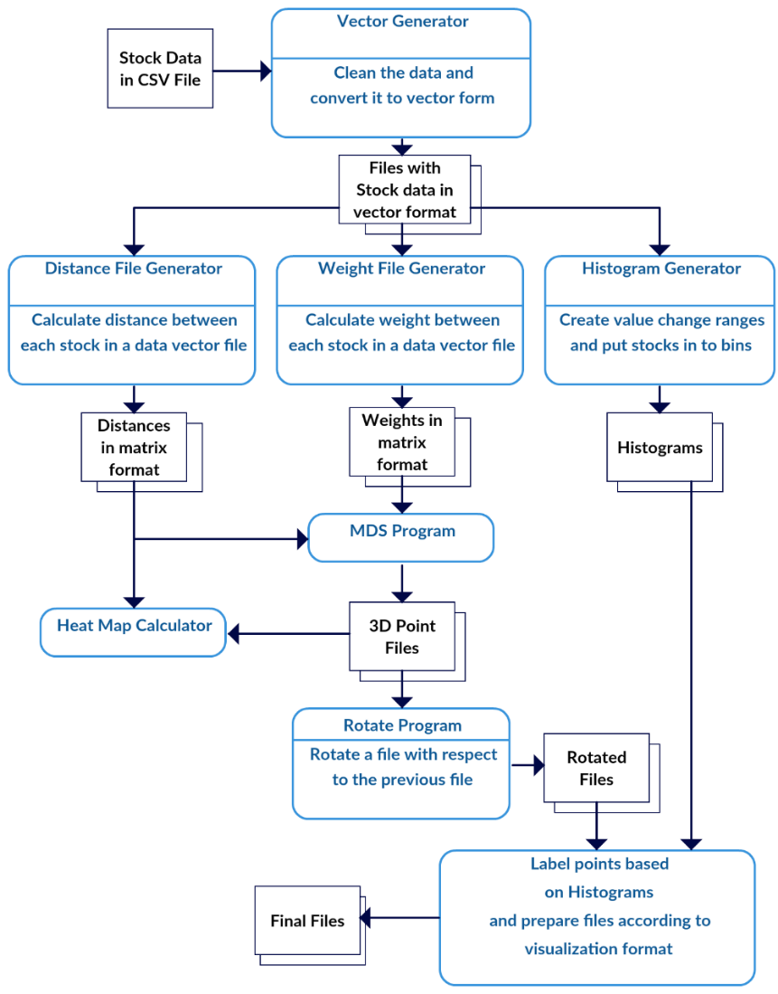
Workflow
Java MPI based scripted workflow
Can generate large amount of data
Distance and weight calculation done in parallel
Alignment program is run in parallel

Slide 8
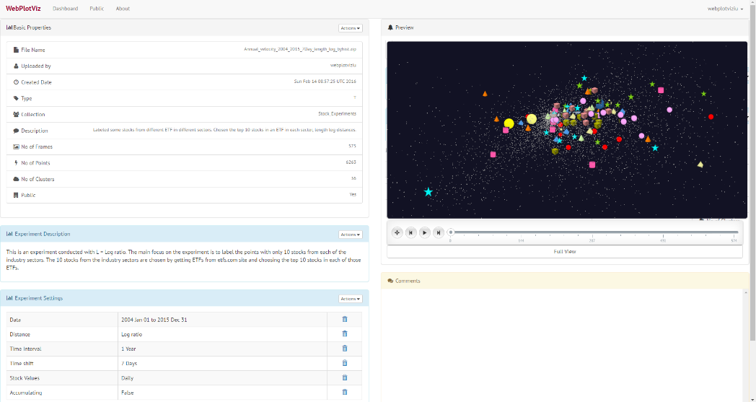
WebPlotViz for Time Series Data Visualization
A Web Browser based 3D Visualization tool
Uses three.js for rendering 3D plots in the browser
Visualize sequence of time series 3D data as a moving plot
Data stored in NoSQL database
Available as a service
http://spidal-gw.dsc.soic.indiana.edu/
https://threejs.org/

Slide 9
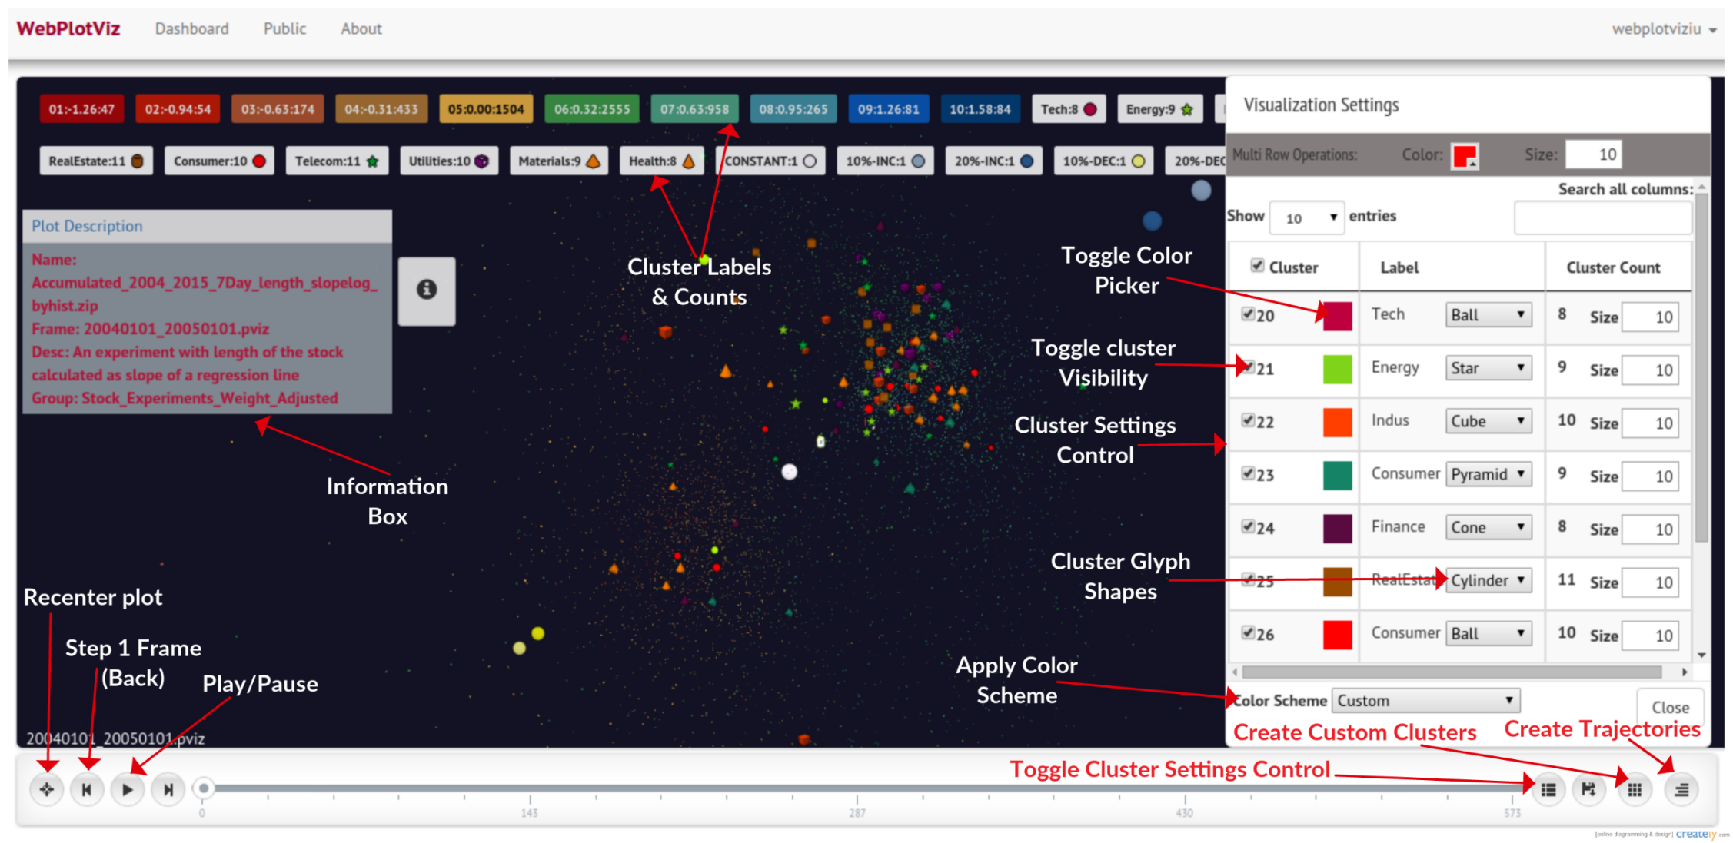
WebPlotViz

Slide 10
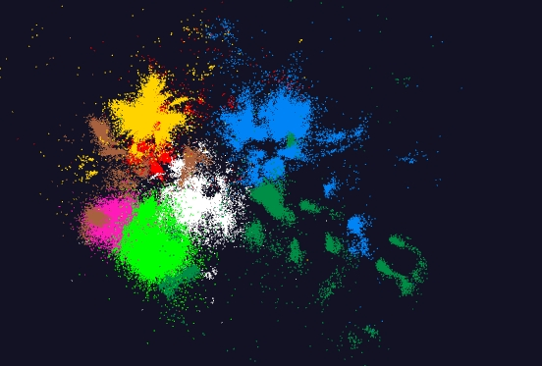
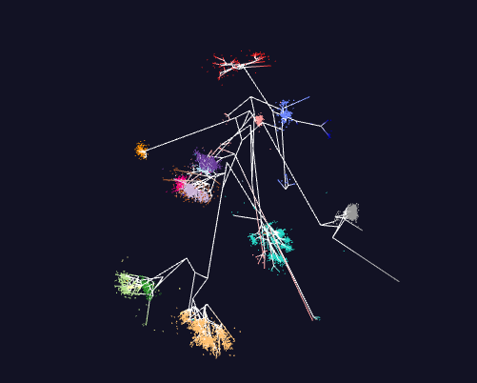
WebPlotViz
Using Play framework as the web framework
Can visualize trees as well as large point plots
Data repository for plots
Front end view (Browser)
Plot visualization & time series animation (Three.js)
Upload
Request Plots
JSON Format Plots
Web Request Controllers (Play Framework)
Server
Upload format to JSON Converter
Data Layer (MongoDB)
MongoDB
100k points
Trees

Slide 11
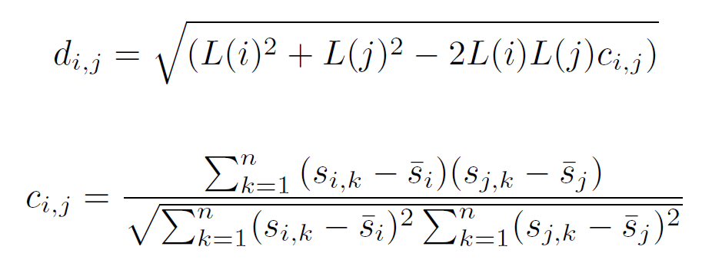
Stock Data
Data obtained from the Center for Research in Security Prices (CRSP) database through the Wharton Research Data Services (WRDS)
Daily stock prices from 2004 to 2015
Each segment have multiple stocks with values for each day in that segment
$$d_{i,j} Distance betwe two stocks i and j$$
$$c_{i,j} Correlation betwe two stocks i and j$$
$s_{i,k} k^{th} value of stock i$
$$L\left(i\right)=1$$
or

Slide 12
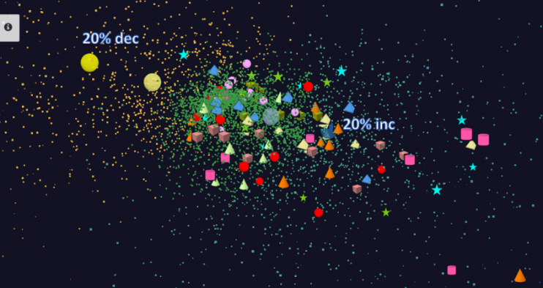
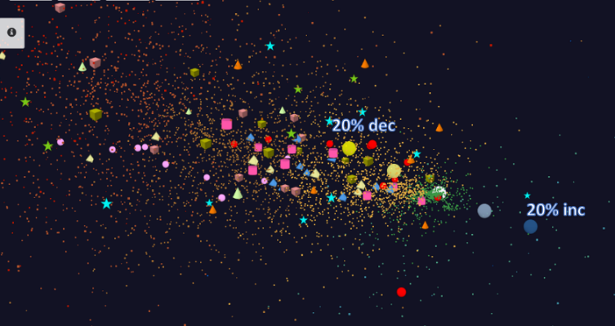
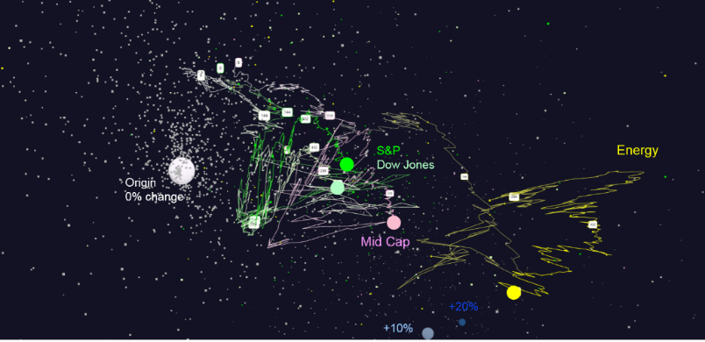
Stocks through time
1 Year time window with 7 day and 1 Day shifts
About 7000 stocks for each time window
Cluster based on ETFs, stock value changes
Trajectories to visualize the movement of stocks through time
For 7 days shifts, 570 data segments, for 1 day shifts 2500 data segments
Trajectories

Slide 13
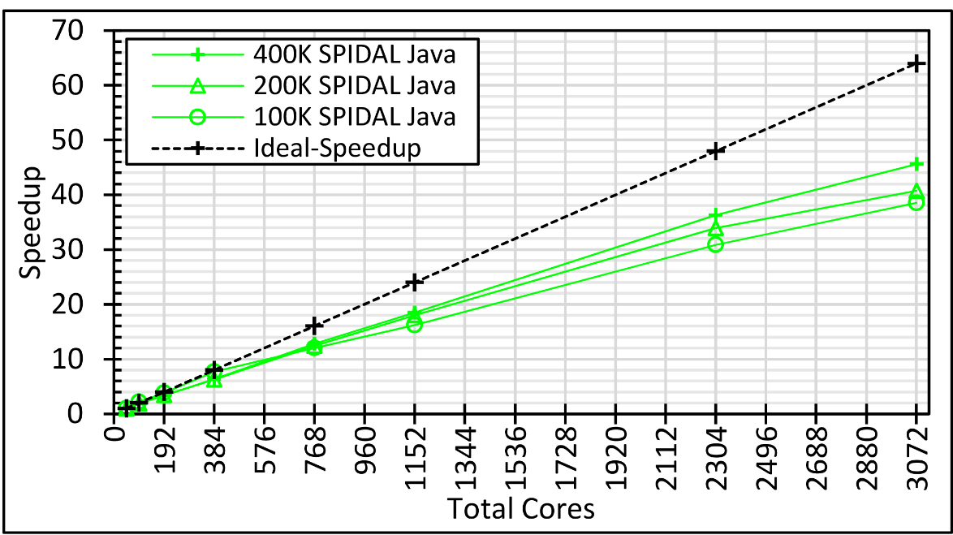
MDS Performance
Many nodes
Small no of nodes

Slide 14
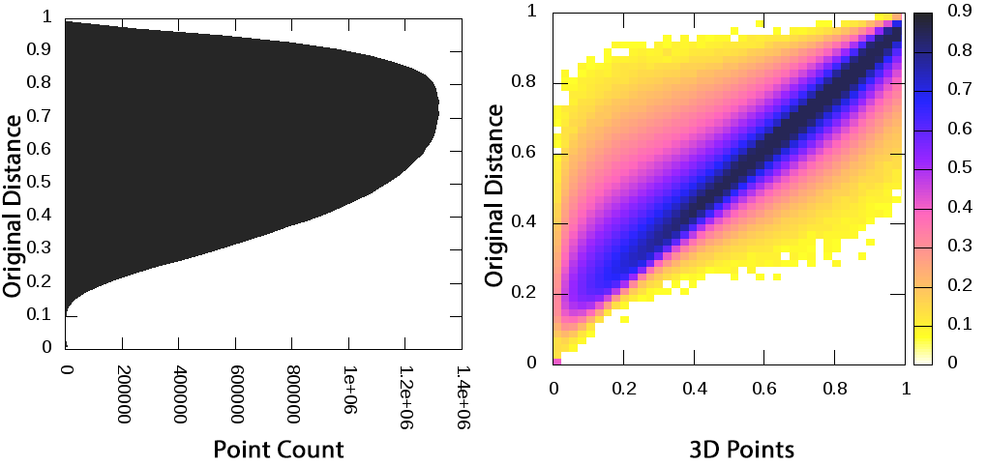
Heat maps for visualizing the MDS approximation
$$L\left(i\right)=1$$

Slide 15
Aligning consecutive plots
Independent MDS
Initialize MDS with previous solution

Slide 16
Lessons Learned
MDS Choices | Pros | Cons
Run MDS independently for each Segment | Can run in parallel for different data segments | Produce local optimal solutions for some data segments randomly
Initialize MDS with previous solution | Produces optimal solutions and runs quickly because the algorithm starts near solution | Needs to run sequentially and best suitable for online processing
MDS Choices
Alignment Choices | Pros | Cons
Respect to common data points for all segments | Can run easily in parallel for different data segments | Doesn’t produce the best alignment
Respect to previous data points | Produce the best rotations when there are overlapping data and shift is small | Needs to run sequentially and best suitable for online processing
MDS Alignment Choices

Slide 17
Future Work
Experiment with other dimension reduction algorithms - PCA, t-SNE
More data sets
Improve WebPlotViz to utilize server level plot data processing
Improve WebPlotViz to handle different types of plots
Online processing of data

Slide 18
Software
WebPlotViz hosted version
https://spidal-gw.dsc.soic.indiana.edu/
WebPlotViz source code
https://github.com/DSC-SPIDAL/WebPViz.git
Multidimensional scaling source code
MPI - https://github.com/DSC-SPIDAL/damds.git
Flink - https://github.com/DSC-SPIDAL/flink-apps
Spark - https://github.com/DSC-SPIDAL/damds.spark.git
Time series workflow source code
https://github.com/DSC-SPIDAL/stock-analysis

Slide 19
References
Deterministic Annealing MDS
Yang Ruan, and Geoffrey Fox. "A robust and scalable solution for interpolative multidimensional scaling with weighting." eScience (eScience), 2013 IEEE 9th International Conference on. IEEE, 2013
MDS Performance with MPI
Saliya Ekanayake, Supun Kamburugamuve, and Geoffrey C. Fox. "SPIDAL Java: High Performance Data Analytics with Java and MPI on Large Multicore HPC Clusters.“ HPC '16 Proceedings of the 24th High Performance Computing Symposium
Saliya Ekanayake, Supun Kamburugamuve, Pulasthi Wickramasinghe, and Geoffrey C. Fox. "Java Thread and Process Performance for Parallel Machine Learning on Multicore HPC Clusters.“ IEEE Big data 2016.

